Slide 1
Learningo

Slide 2
Introduction
Welcome
Learningo started as a week long project by a Thinkful Student to demonstrate the concept of “spaced repetition”. Spaced repetition is an algorithm used in technology to increase intervals between concepts already mastered and more frequently show others.

Slide 3
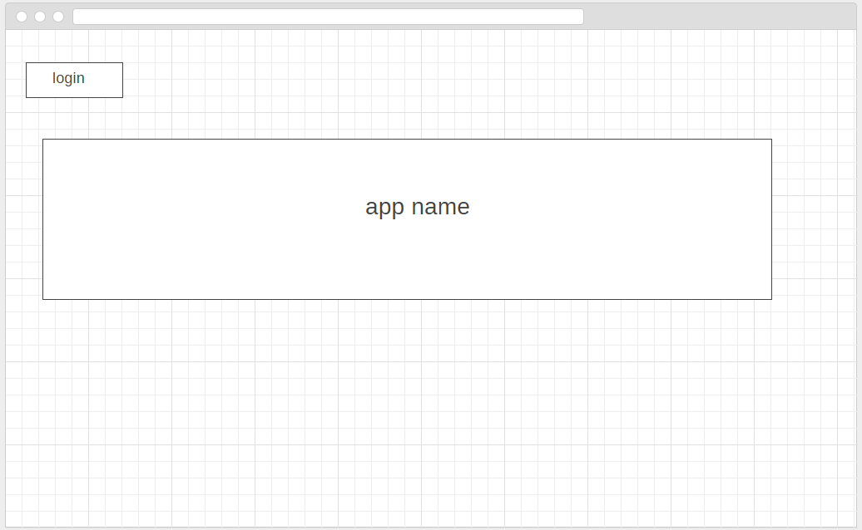
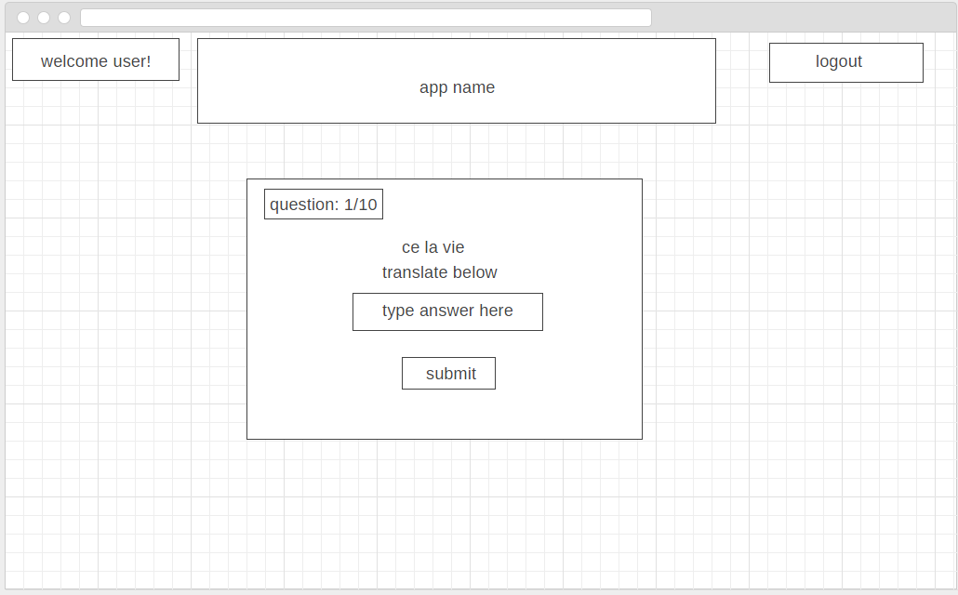
wireframes

Slide 4
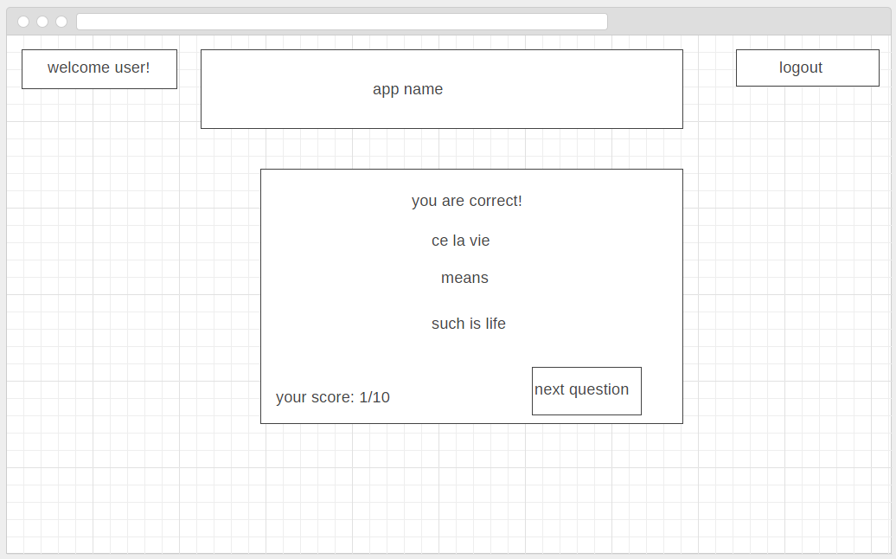
More wireframes

Slide 5
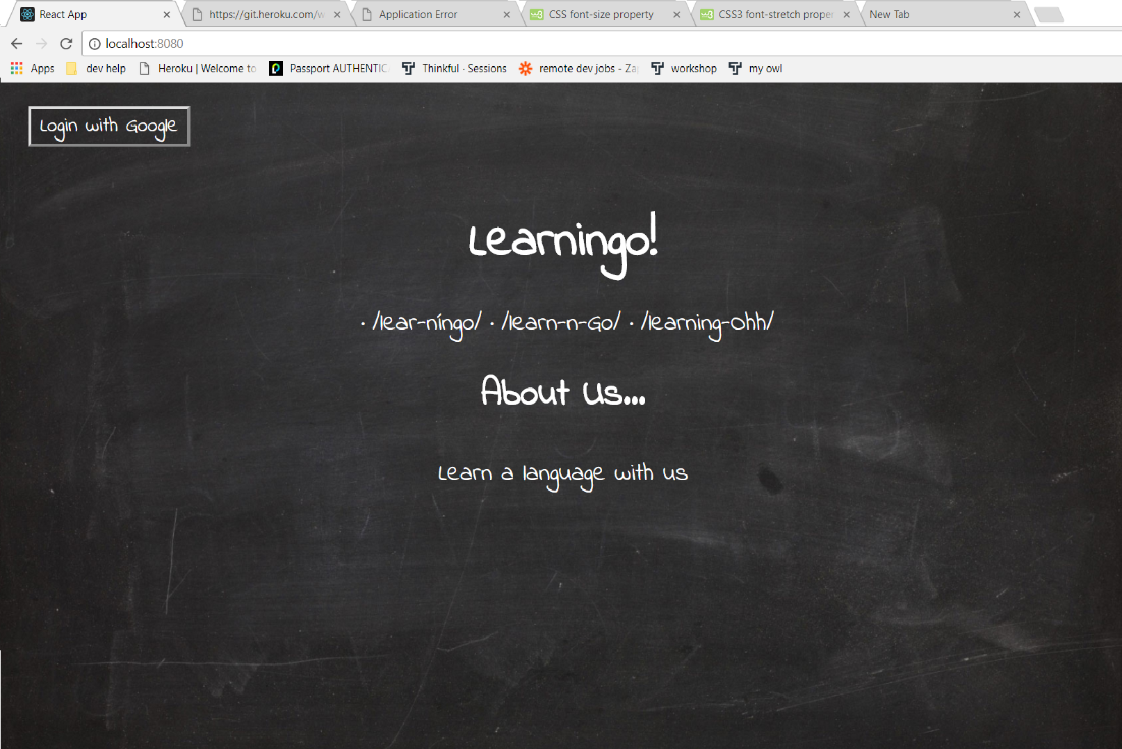
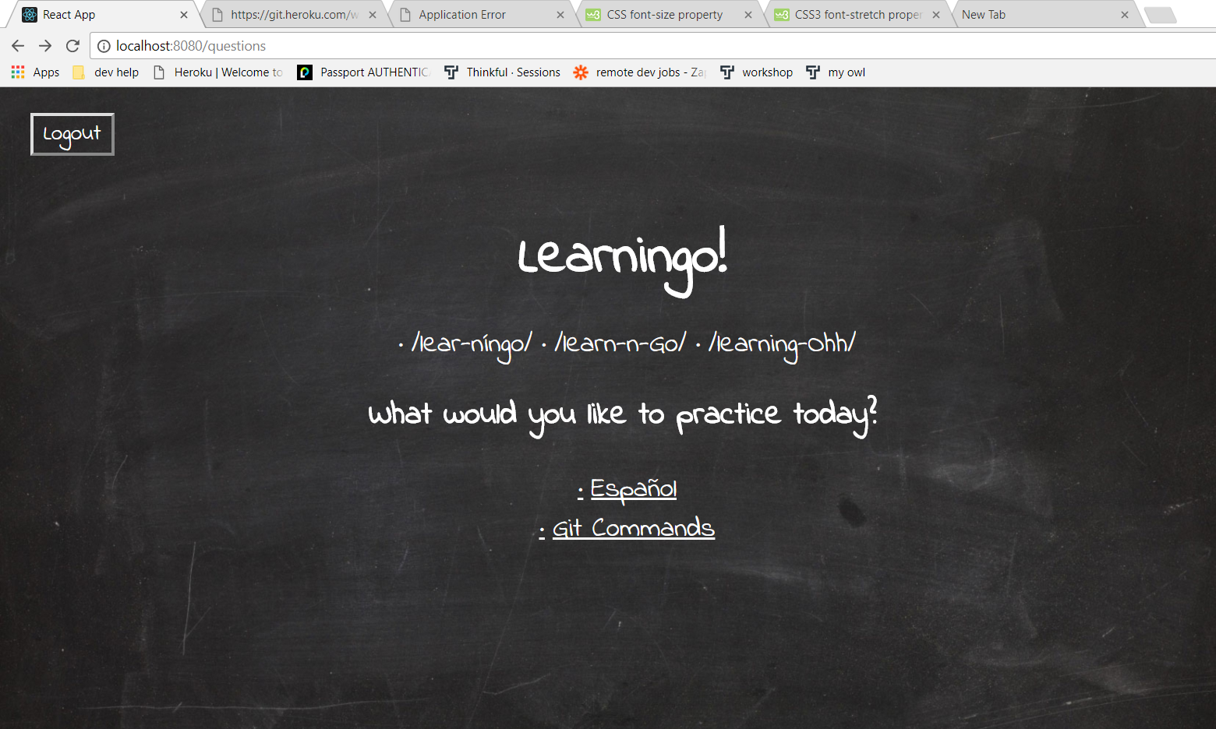
Actual app

Slide 6
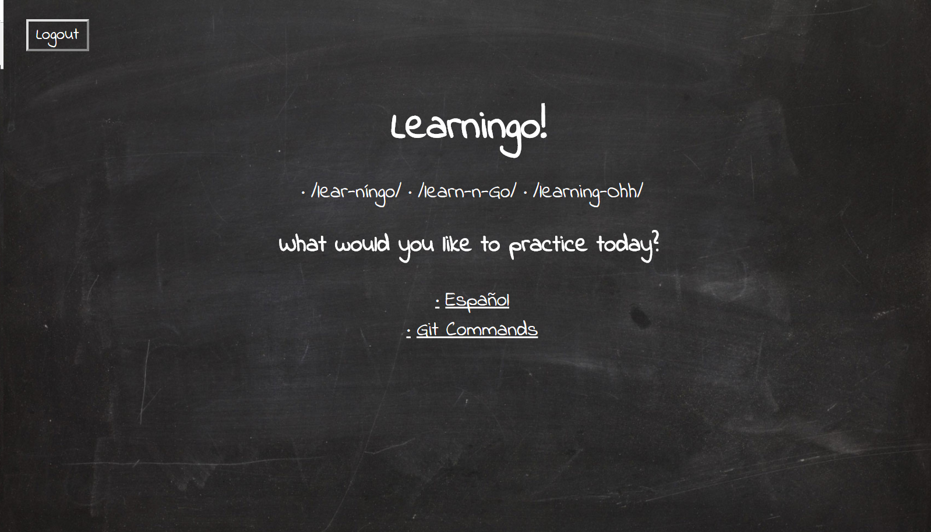
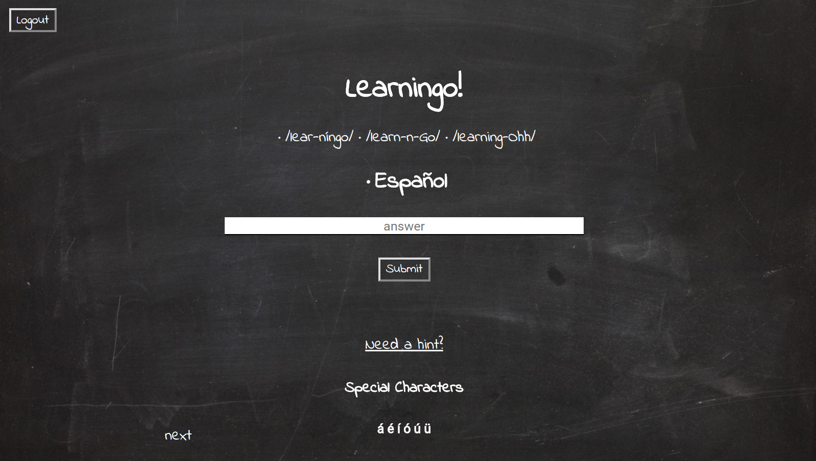
Actual app (cont)

Slide 7
features
One advantage over our competition is that this app is designed to contain multiple lessons for a user.
We wanted users to be able to request content. If the lessons we have are not the ones you currently need, feel free to email support and we will add it for you!
With our implementation of spaced repetition you will continue to be drilled on those question that you answer incorrectly—until your done.

Slide 8
Hurdles
Many of the hurdles we faced were data related.
It is important to use good debugging techniques to help see just how your data is flowing through your app.
And to be honest it is quite fascinating!
Other hurdles were time constraints. We wanted a production ready app but in a week time we provided a solid MVP to demo what lies ahead for Learningo.

Slide 9
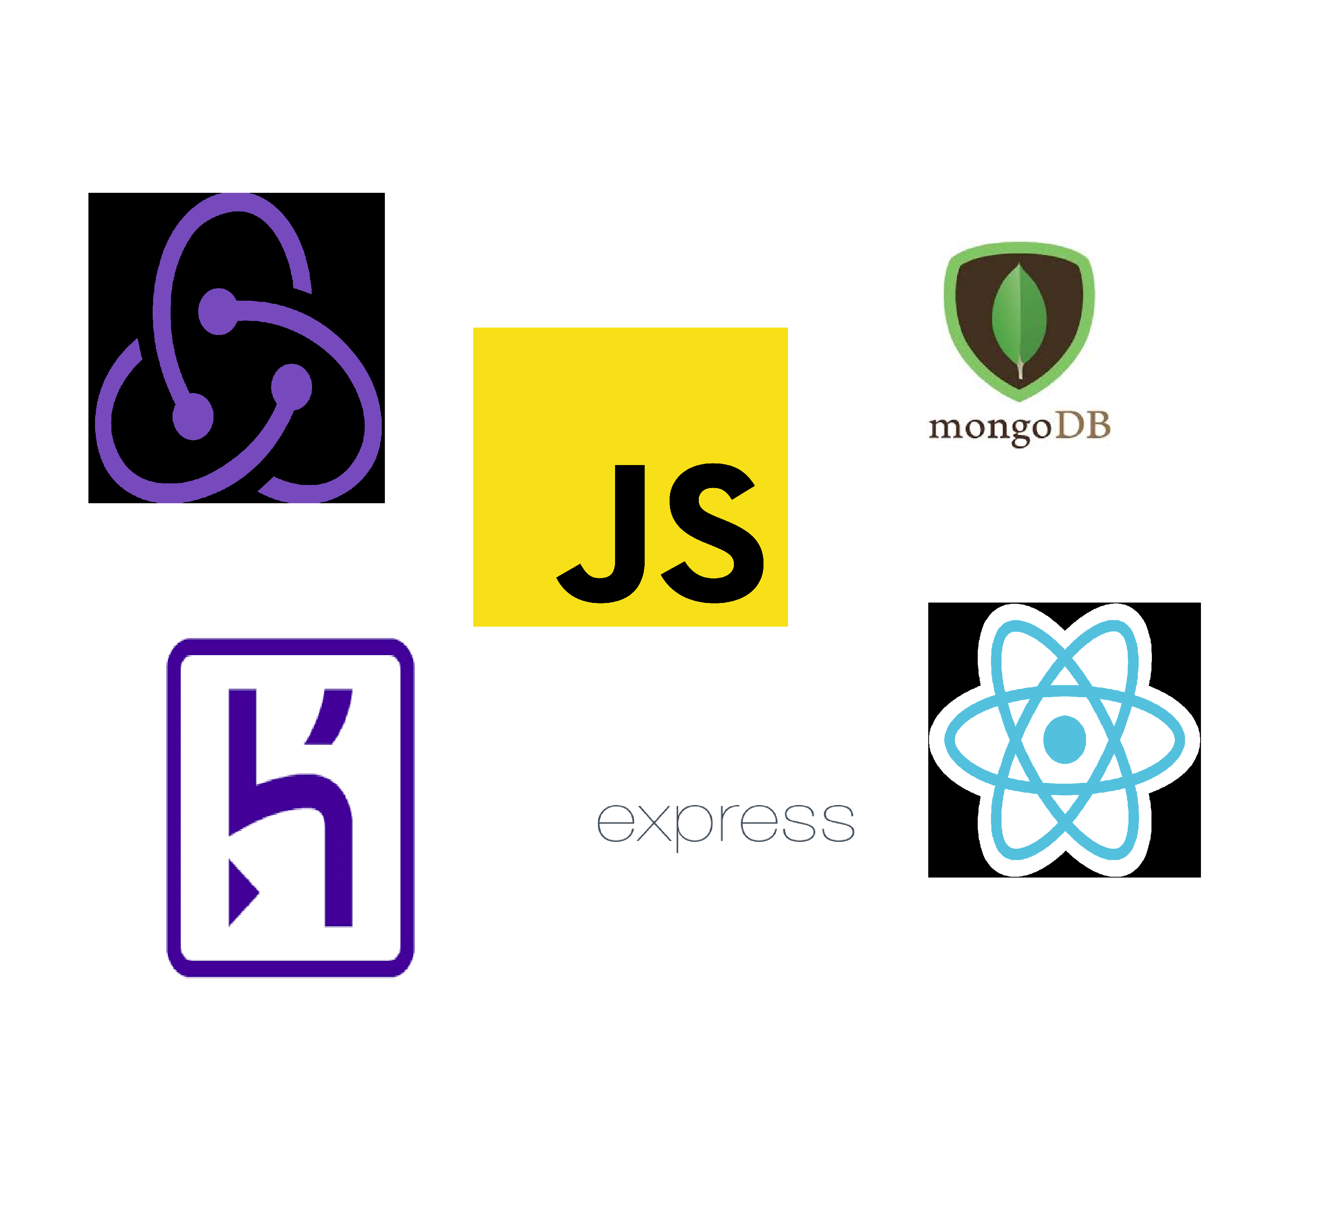
The stack
The technologies we used for this app are as follows:
JS, React, Redux, XML, CSS, HTML
Node.js, Express, Mongoose, Passport, Google OAuth
Mlab and Heroku
VS Code, Chrome DevTools, React and Redux DevTools

Slide 10
fin

